Slide 1
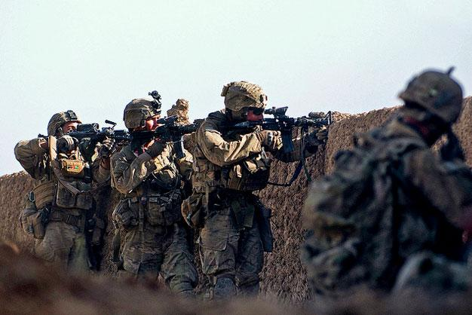
Introduction to Battle Drills

Slide 2
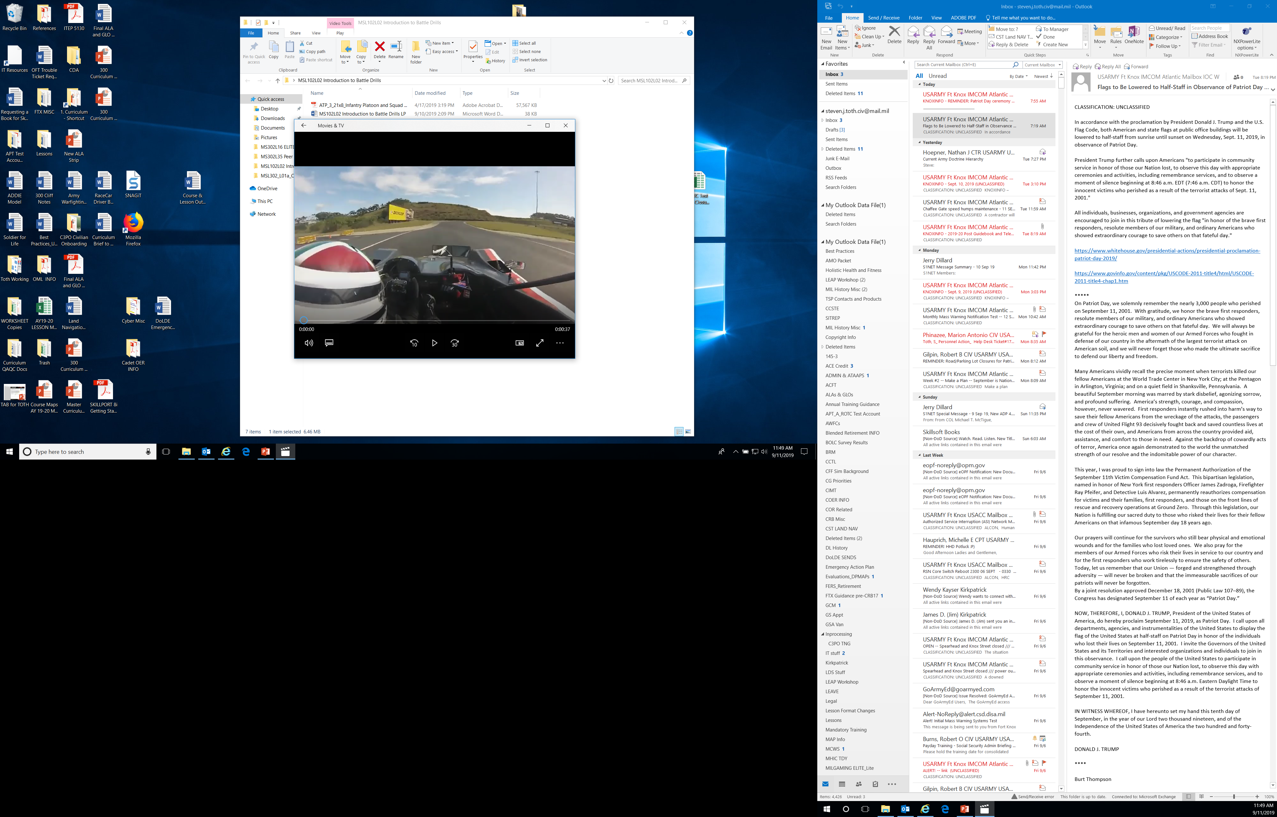
Why do we Drill?
‘Why do we Drill?’

Slide 3
Learning Objectives
Explain the purpose and characteristics of Battle Drills
Identify four main Battle Drills
Explain the individual’s role within selected Battle Drills

Slide 4
Purpose of Battle Drills
Group skills designed to train a unit to react and survive in common combat situations
Designed for rapid reaction situations without the application of a deliberate decision-making process.

Slide 5
Characteristics of Battle Drills
Standardized collective actions made in response to common battle occurrences
Initiated on a cue
Trained response to a stimulus
Require minimal leader orders to accomplish
Vital to success in combat and critical to preserving life
Designed for rapid reaction situations without the application of a deliberate decision-making process

Slide 6
Battle Drills
Establish Security at the Halt
React to Contact
React to Ambush (Near)
React to Indirect Fire
NOTE: Each drill is made up of individual tasks.

Slide 7
Establish Security at the Halt
Key Steps:
Unit leader gives arm-and-hand signal to halt
Soldiers establish local security
Element leaders adjust positions as necessary
Unit Leaders report situation to higher headquarters

Slide 8
React to Contact
Key Steps:
Begins when the enemy initiates direct fire contact
Element in contact returns fire and seeks cover
Element in contact locates the enemy and places well-aimed fire on enemy positions
Unit Leaders report the contact to higher headquarters

Slide 9
React to Ambush (Near)
Key Steps:
Begins when the unit is moving tactically and receives accurate enemy direct fire within hand grenade range
Soldiers in the kill zone immediately return fire on known or suspected enemy positions
Soldiers not in kill zone place well aimed suppressive fire on the enemy
Unit assaults through the kill zone to destroy the enemy
Unit Leaders report the contact to higher headquarters

Slide 10
React to Indirect Fire
Key Steps:
Begins when any squad member alerts “INCOMING” or a round impacts
Soldiers immediately seek the best available cover
Units move to designated rally points after the impacts
Unit Leaders report the contact to higher headquarters

Slide 11
Practical Exercise
Instructions:
Count off by fours, and divide into four equal groups; each stand next to a whiteboard or butcher block paper
Select a group Leader, one per group
Fall into assigned Battle Drills by your numbered group (1’s = Establish Security at the Halt; 2’s = React to Contact; 3’s = React to Ambush (Near); 4’s = React to Indirect Fire)
Each group has five (5) minutes to recall and annotate the major steps (in order) of your assigned Battle Drill
Be prepared to discuss the steps, and take comments from other groups

Slide 12
Closing
Review Learning Objectives:
Explain the purpose and characteristics of Battle Drills
Identify four main Battle Drills
Explain the individual’s role within selected Battle Drills
Questions:
Next Lesson:
CADET POST-CLASS ASSIGNMENT:
Complete writing program journal assignment (one paragraph); turn in next class
Complete any Student Reading assignments, if required

